Slide 1


Fifteen Puzzle Game
Sarah Mustafa, Jenifer Nguyen, Tariq Fletcher

Slide 2
Team Structure
Sarah Mustafa: Lead Programmer, Designer
Jenifer Nguyen: Leader, Programmer, Tester
Tariq Fletcher: Programmer, Tester, Video Editor

Slide 3
Objectives and Challenges
Objectives:
Create an engaging and functional Fifteen puzzle game.
Integrate DevOps
Challenges:
Bugs
Logic Implementation
UX/UI Design

Slide 4
Introduction
Fifteen Puzzle Overview:
An engaging tile-based puzzle where the goal is to rearrange numbered tiles into numerical order.
Each move involves sliding a tile into the empty space, progressively solving the puzzle.
Collaboration of Technologies:
Cohesive and dynamic user experience created with HTML, CSS, and JS
Efficiency and Simplicity:
Leveraged the strengths of each technology to create an efficient, responsive, and visually appealing puzzle game.

Slide 5
Tech Stack
HTML (Hypertext Markup Language):
Create the structural foundation.
Layout and arrangement of elements
CSS (Cascading Style Sheets):
Styling and appearance of the game interface.
Colors, fonts, and overall aesthetics.
JavaScript:
Interactive game mechanics.
Shuffle tiles
Facilitates user interactions

Slide 6
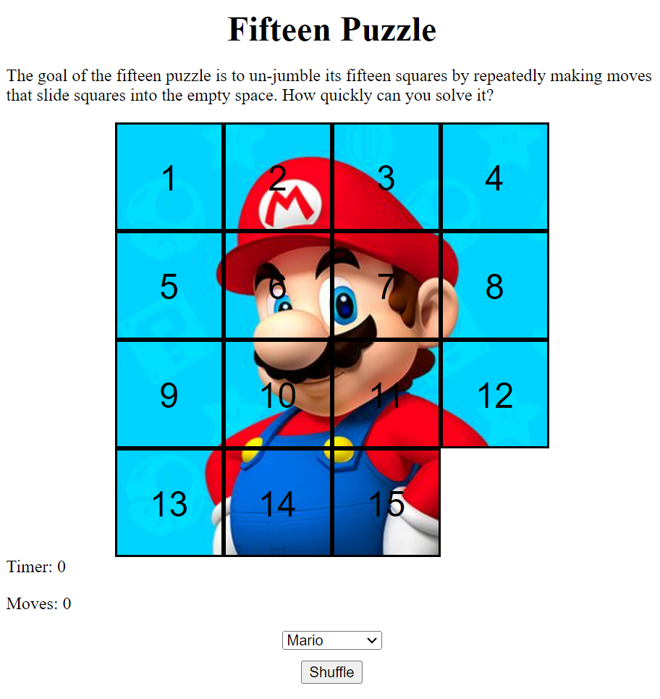
Game Initialization
Setting Up the Initial Puzzle Board:
Set up initial configuration of puzzle board.
Arrange tiles in numerical order with one tile missing.
Displaying the Background Image:
Create a visually engaging puzzle board with a selected image
Background image is applied to all tiles for a cohesive look.

Slide 7
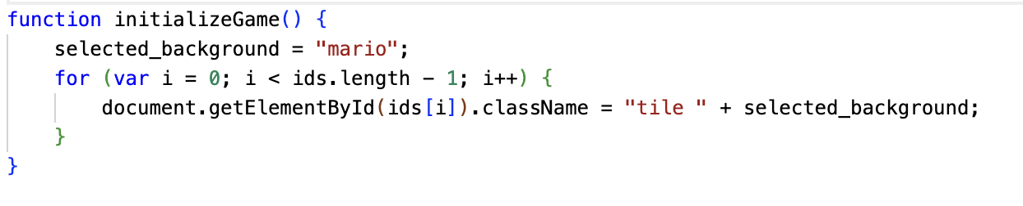
Game Initialization

Slide 8
Shuffling the Puzzle
Algorithm for Randomizing the Puzzle:
The game shuffles the puzzle for a randomized start by iterating through steps in a loop.
Ensuring Solvability:
The shuffling algorithm ensures the puzzle remains solvable by making valid moves during the shuffling process.
The shuffleBoard function randomizes the puzzle by executing a specific number of valid moves, updating the display to show the new shuffled configuration.

Slide 9
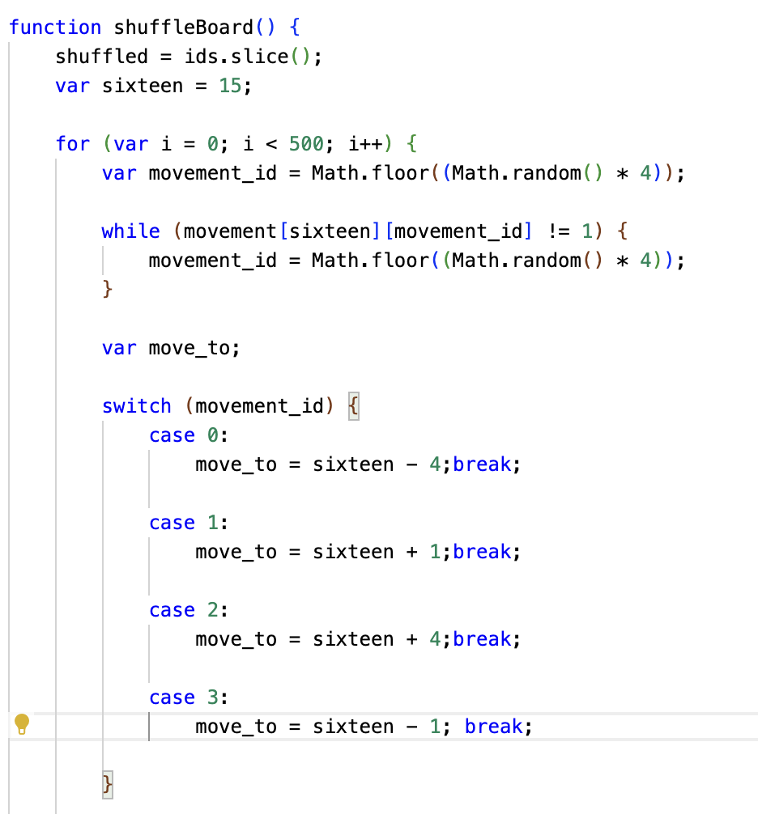
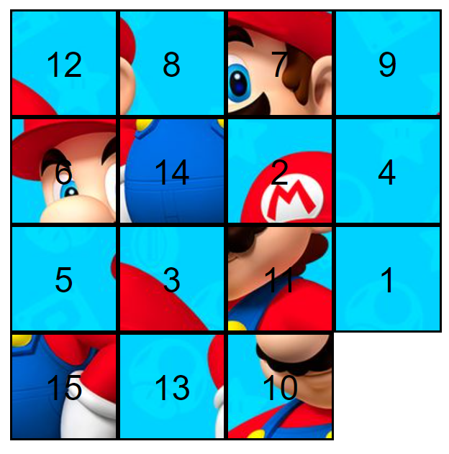
Shuffling the Puzzle

Slide 10
Displaying the Puzzle
Displaying the Shuffled Puzzle:
The displayBoard function renders the shuffled puzzle on the user interface.
It dynamically creates HTML elements representing each tile and updates their positions based on the shuffled configuration.
Interactive Clickable Tiles:
Clickable tiles are determined by the valid moves from the empty space.
These tiles are visually highlighted and made interactive, allowing players to make valid moves by clicking.

Slide 11
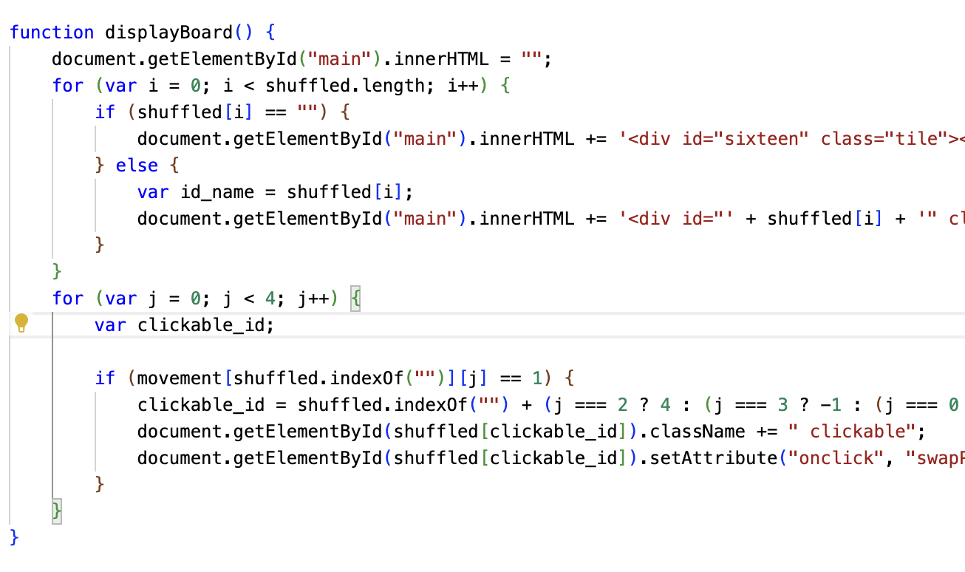
Displaying the Puzzle

Slide 12
Displaying the Puzzle
Displaying the Shuffled Puzzle:
The displayBoard function renders the shuffled puzzle on the user interface.
It dynamically creates HTML elements representing each tile and updates their positions based on the shuffled configuration.
Interactive Clickable Tiles:
Clickable tiles are determined by the valid moves from the empty space.
These tiles are visually highlighted and made interactive, allowing players to make valid moves by clicking.

Slide 13
User Interaction
User Interaction & Moves:
Players interact by clicking tiles, swapping them with the adjacent empty space. Each click increments the moves variable, tracked to determine puzzle completion.
The swapPieces function:
Triggered by a clickable tile click.
Swaps the clicked tile with the empty one.
Increments the moves.
Updates the game board via the displayBoard function.

Slide 14
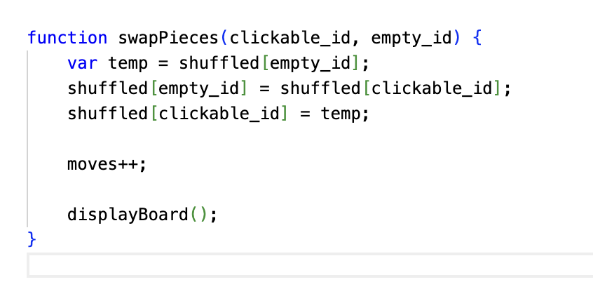
User Interaction

Slide 15
CODE SUMMaRY
initializeGame: Sets up the initial puzzle board.
shuffleBoard: Randomizes the puzzle for a new game.
User interactions managed by swapPieces.
displayBoard: Renders the shuffled puzzle on the UI, enabling interaction with clickable tiles.

Slide 16
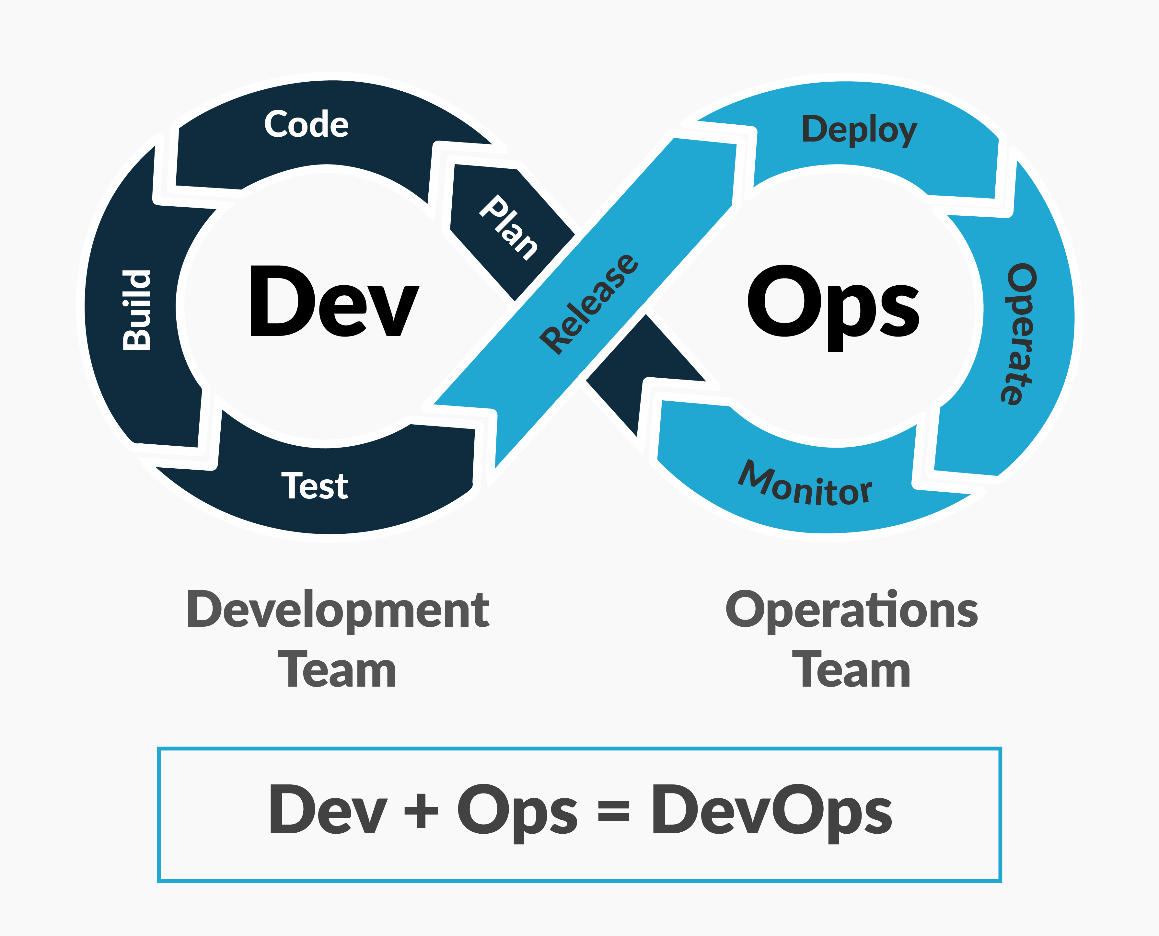
DevOps Methodology
DevOps: Planning, Testing, Deployment
Enhanced Collaboration,
Faster Development
Reduced bugs

Slide 17
Testing
Tested on multiple platforms
Fixed bugs
Fixed images not rendering when selected
Adding animations froze the game
Fixed music not starting
Considered UI/UX principles

Slide 18
THANK YOU!

